Slide 1
CLASS 5 Functions and Classes

Slide 2
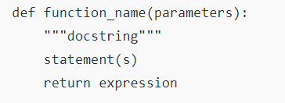
INTRODUCTION TO FUNCTIONS
A function is a block of code which only runs when it is called.
You can pass data, known as parameters, into a function.
A function can return data as a result.
SYNTAX

Slide 3
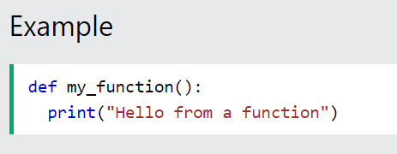
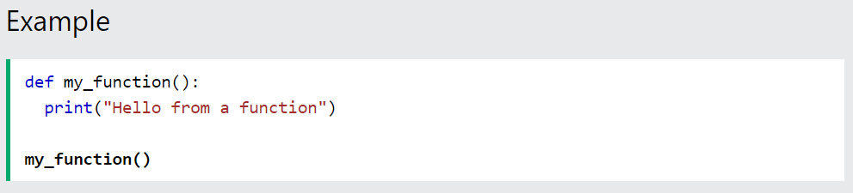
Creating a Function
In Python a function is defined using the def keyword:
Calling a Function
To call a function, use the function name followed by parenthesis:

Slide 4
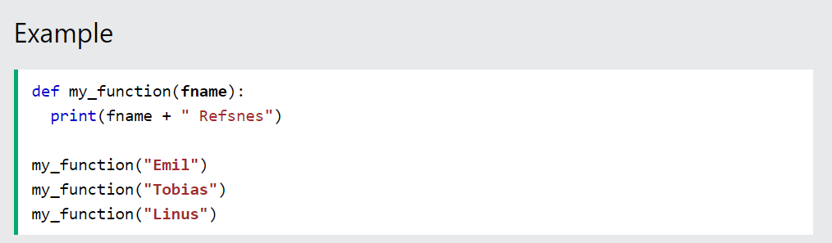
Arguments
Information can be passed into functions as arguments.
Arguments are specified after the function name, inside the parentheses. You can add as many arguments as you want, just separate them with a comma.
The following example has a function with one argument (fname). When the function is called, we pass along a first name, which is used inside the function to print the full name:

Slide 5
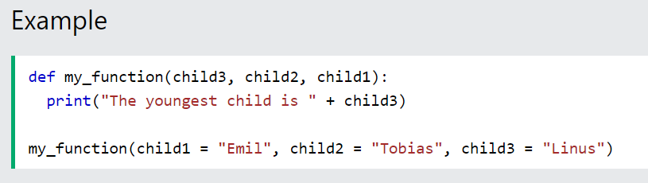
Keyword Arguments
You can also send arguments with the key = value syntax.
This way the order of the arguments does not matter.
The phrase Keyword Arguments are often shortened to kwargs in Python documentations.

Slide 6
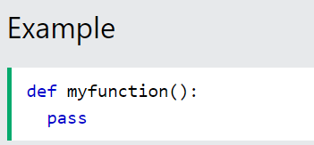
The pass Statement
function definitions cannot be empty, but if you for some reason have a function definition with no content, put in the pass statement to avoid getting an error.

Slide 7
Global variables are those which are not defined inside any function and have a global scope whereas local variables are those which are defined inside a function and its scope is limited to that function only. In other words, we can say that local variables are accessible only inside the function in which it was initialized whereas the global variables are accessible throughout the program and inside every function.
Local Variables
Local variables are those which are initialized inside a function and belongs only to that particular function. It cannot be accessed anywhere outside the function. Let’s see how to create a local variable.

Slide 8
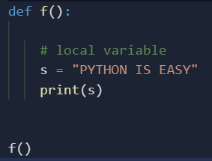
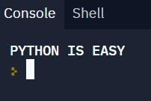
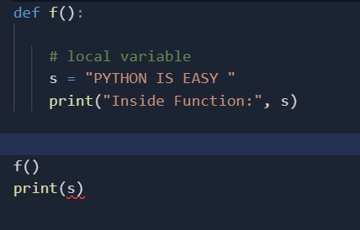
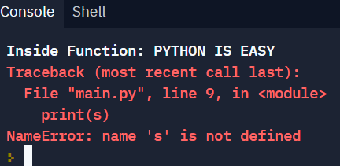
Local Variables
Local variables are those which are initialized inside a function and belongs only to that particular function. It cannot be accessed anywhere outside the function. Let’s see how to create a local variable.
If we will try to use this local variable outside the function then let’s see what will happen.

Slide 9
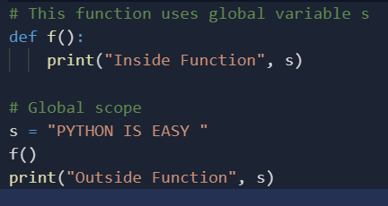

Global Variables
The global variables are those which are defined outside any function and which are accessible throughout the program i.e. inside and outside of every function Let’s see how to create a global variable.

Slide 10
Note: As there are no locals, the value from the globals will be used.
Now, what if there is a variable with the same name initialized inside a function as well as globally. Now the question arises, will the local variable will have some effect on the global variable or vice versa, and what will happen if we change the value of variable inside of the function f()? Will it affect the globals as well? We test it in the following piece of code:
Python3
# This function has a variable with # name same as s. def f(): s = "Me too." print(s) # Global scope s = “PYTHON IS EASY " f() print(s)
Output:
Me too. PYTHON IS EASY .
If a variable with the same name is defined inside the scope of function as well then it will print the value given inside the function only and not the global value.

Slide 11

Python Scope
❮
A variable is only available from inside the region it is created. This is called scope.
Local Scope
A variable created inside a function belongs to the local scope of that function, and can only be used inside that function.
Example
A variable created inside a function is available inside that function:
def myfunc(): x = 300 print(x) myfunc()

Slide 12
Naming Variables
If you operate with the same variable name inside and outside of a function, Python will treat them as two separate variables, one available in the global scope (outside the function) and one available in the local scope (inside the function):
Global Keyword
If you need to create a global variable, but are stuck in the local scope, you can use the global keyword.
The global keyword makes the variable global.
Also, use the global keyword if you want to make a change to a global variable inside a function.

Slide 13
Python lambda
In Python, anonymous function means that a function is without a name. As we already know that def keyword is used to define the normal functions and the lambda keyword is used to create anonymous functions. It has the following syntax:
lambda arguments : expression
This function can have any number of arguments but only one expression, which is evaluated and returned.
One is free to use lambda functions wherever function objects are required.
You need to keep in your knowledge that lambda functions are syntactically restricted to a single expression.
It has various uses in particular fields of programming besides other types of expressions in functions.

Slide 14
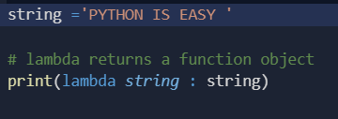

In this above example, the lambda is not being called by the print function but simply returning the function object and the memory location where it is stored. So, to make the print to print the string first we need to call the lambda so that the string will get pass the print.

Slide 15

Example #2: Difference between lambda and normal function call
def cube(y):
return y*y*y;
g = lambda x: x*x*x
print(g(7))
print(cube(5))

Slide 16
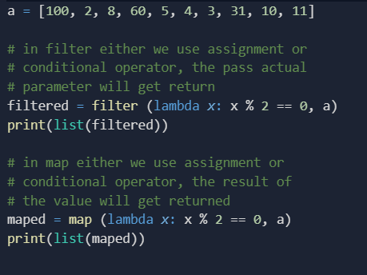
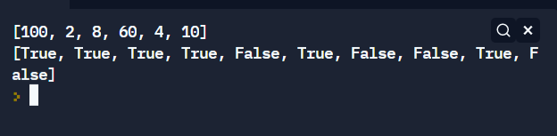
Example #3: filter() and map(
OUTPUT :

Slide 17
Python Classes/Objects Python is an object oriented programming language. Almost everything in Python is an object, with its properties and methods. A Class is like an object constructor, or a "blueprint" for creating objects. To understand the need for creating a class let’s consider an example, let’s say you wanted to track the number of dogs that may have different attributes like breed, age. If a list is used, the first element could be the dog’s breed while the second element could represent its age. Let’s suppose there are 100 different dogs, then how would you know which element is supposed to be which? What if you wanted to add other properties to these dogs? This lacks organization and it’s the exact need for classes.

